Slide 1



PREDICT PRESON’S PERSONALITY TRAITS BASED ON TEXUAL DATA USING MACHINE LEARNING MODEL
SHRI KRISHNASWAMY COLLEGE FOR WOMEN
DEPARTMENT OF COMPUTER SCIENCE WITH DATA SCIENCE
GUIDE
Ms. RADHA.D, MCA,M.E,(PH.D)
TEAM MEMBERS:
ANUSHKA PATHAK
NUSRATH SULTHANA S
MEENALOSHINI S
SAKTHIPRIYA K
DEPARMENT:
III BSC (CS-DS)

Slide 2
OUTLINE
Abstract
Introduction
Existing Approaches/Related Works
Problems in Existing Approaches
Proposed Methodology /Algorithm used
Architecture/ Block diagram
Results and Discussion
Conclusions and Future Work
References

Slide 3
ABSTRACT
This project focuses on predicting a person’s MBTI (Myers-Briggs Type Indicator) personality type using Natural Language Processing (NLP) techniques.
User-generated text data is analyzed to classify individuals into one of the 16 MBTI personality types.
A dataset containing thousands of personal blog posts labeled with personality types is used for model training.
Text preprocessing involves cleaning, tokenization, stop word removal, and vectorization using TF-IDF
A machine learning pipeline is built using Logistic Regression for accurate classification.
The final output is integrated with a Gradio-based user interface, showing predicted personality type, cartoon images, and a creative description.
This system can help in career guidance, team building, and understanding individual traits better through AI-powered analysis.

Slide 4
INTRODUCTION
Personality prediction plays a vital role in areas such as psychology, recruitment, counseling, and personalized recommendations.
The MBTI framework classifies people into 16 types based on four dichotomies: Introversion/Extraversion, Sensing/Intuition, Thinking/Feeling, and Judging/Perceiving.
Social media and user-generated text provide rich behavioral data that can be analyzed using NLP techniques.
This project leverages machine learning to interpret text and classify the user’s personality accurately.
The motivation is to create an engaging, intelligent system that can predict personality based on natural language rather than traditional tests.
The model is trained on real MBTI-labeled data and evaluated for performance, providing an innovative use of NLP in psychological profiling.

Slide 5
EXISTING APPROACHES / RELATED WORK
Big Five Personality Traits Foundation: Goldberg (1993) introduced the Big Five model, which became a cornerstone for both psychological and computational personality analysis.
Text-Based Personality Classification: Jha and Ghosh (2020) showcased the effectiveness of NLP techniques such as TF-IDF and word embeddings in predicting personality traits from unstructured text sources.
Cross-Cultural Validation : Costa and McCrae (1992) confirmed that the Big Five traits are consistent across diverse cultures and demographics, validating their use in automated personality detection system
Machine Learning Algorithms: Kaur and Kaur (2019) implemented machine learning techniques like Decision Trees, Support Vector Machines (SVM), and deep learning to extract and classify personality traits from textual data with promising accuracy.
Data Sources: Most existing approaches use blog posts, social media updates, and forum threads to capture natural language-based personality traits.
Challenges Identified: Common issues include noisy data, poor generalization to unseen text, and the requirement for advanced feature engineering for reliable predictions

Slide 6
PROBLEMS IN EXISTING APPROACHES
Subjectivity and Bias: Traditional methods depend on self-assessment questionnaires, which are susceptible to social desirability bias and inaccurate self-perception.
Inconsistency Over Time: User inputs in surveys can vary based on emotional state or context, affecting the consistency of the results.
Manual Evaluation Dependency: Results often require professional interpretation (psychologists/HR), making it resource-heavy and inefficient for large-scale applications.
No Real-Time Capability: Existing tools lack the ability to analyze personality dynamically from real-time text like social media interactions or chat transcripts.
Limited Adaptability: Older systems are not designed to adapt to evolving language trends, emojis, or internet slang, which reduces their relevance in modern digital communication.
Salability Issues: Manual systems and traditional tools struggle to process large datasets efficiently for mass personality profiling.
Lack of Engagement : Survey-based systems may feel impersonal and static, whereas text-based prediction can be integrated into interactive applications like chatbots or online platforms.

Slide 7
PROPOSED METHODOLOGY/ALGORITHMS USED
Traditional ML Algorithms :
Logistic Regression: Effective for binary and multiclass classification of personality types.
Random Forest: Uses multiple decision trees to improve prediction accuracy.
SVM: Suitable for high-dimensional text classification using optimal hyperplanes.
Deep Learning Models:
LSTM: Captures long-term dependencies in text, useful for understanding sequence and flow.
BERT: Understands word context in both directions for better accuracy.
Purpose: Classify personality traits using processed text; models are compared to choose the best.
Flask Framework for Web Application :
Purpose: Deploys the trained model as a web-based application.
Key Features: Lightweight and ideal for small-scale apps; uses Jinja2 for dynamic HTML rendering.

Slide 8
Sure! Here's the shortened version, perfect for a slide:
PROPOSED METHODOLOGY/ALGORITHMS USED
Algorithms Used :
ML Models: Logistic Regression, Random Forest, SVM
DL Models: LSTM and BERT for deeper language understanding
Data Collection:
Source: Public datasets (e.g., Kaggle)
Based on Big Five (OCEAN) personality traits
Data Size:
of text samples (essays, social media posts)
Each labeled with trait scores (e.g., Openness, Neuroticism)
Tokenization & Feature Extraction:
Preprocessing: Lemmatization, stopword removal, normalization
Methods: TF-IDF, Word2Vec, GloVe, BERT embeddings

Slide 9
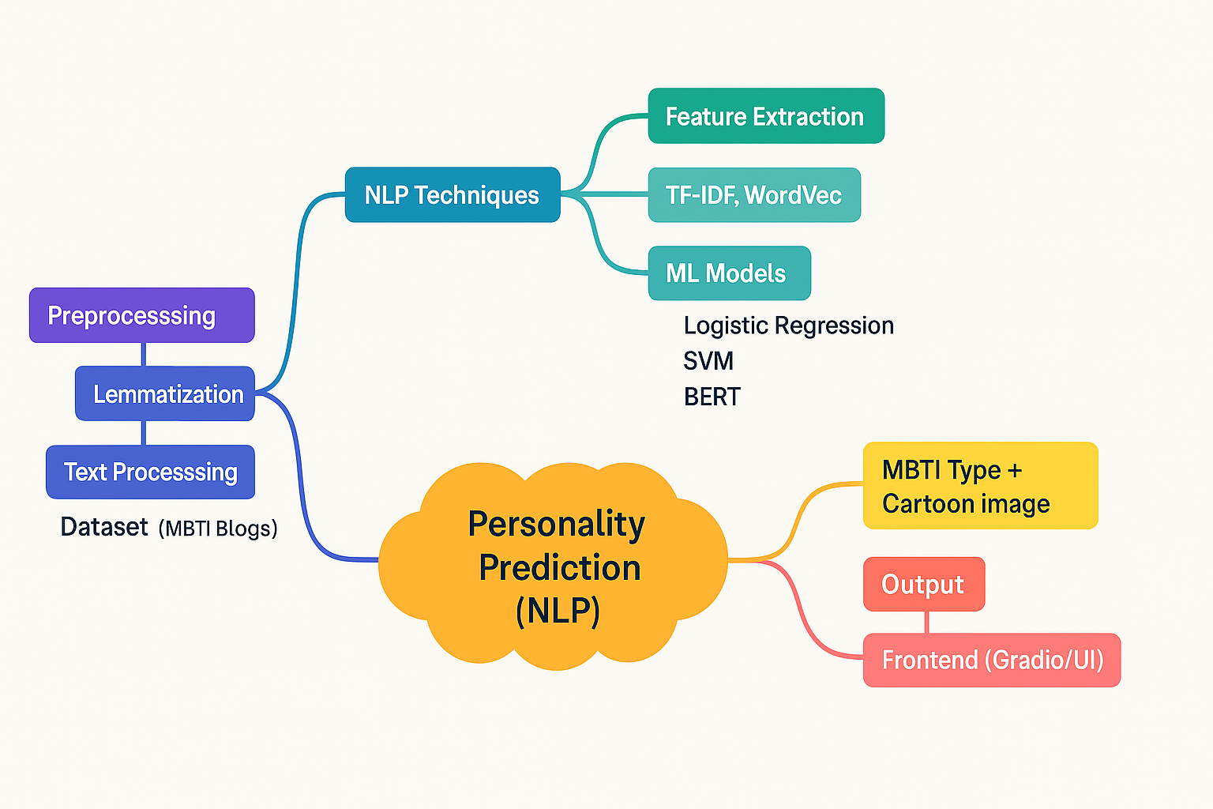
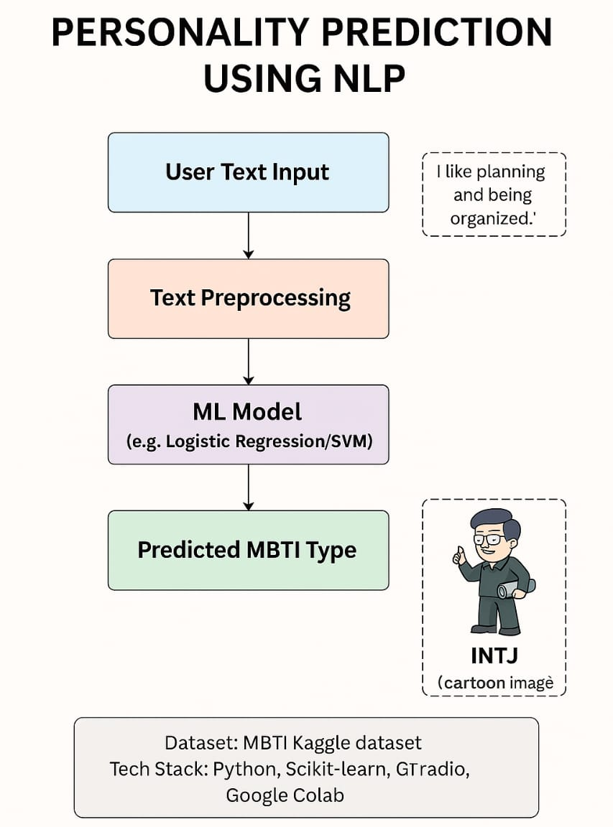
ARCHITECTURE/BLOCK DIAGRAM
DIAGRAM:

Slide 10
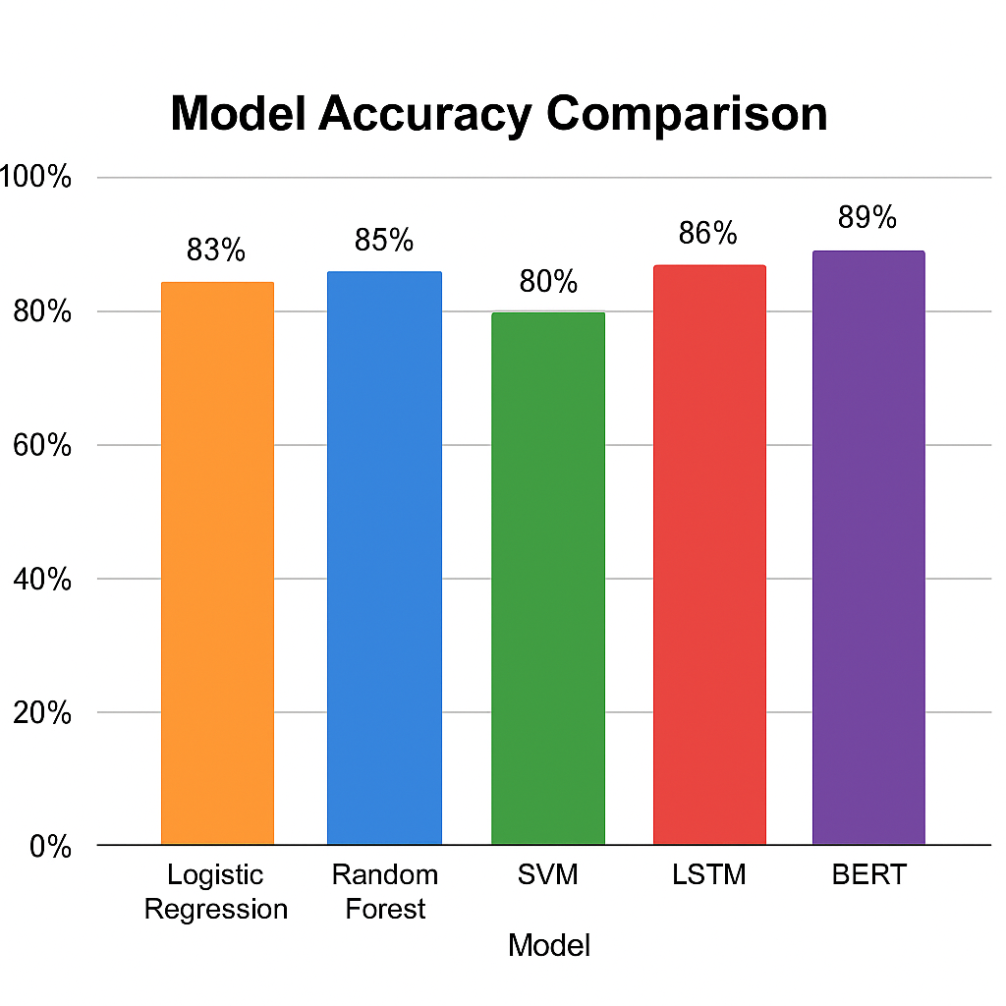
RESULTS AND DISCUSSION
The performance of various models was evaluated based on their accuracy in predicting personality traits from user-generated text. Among traditional machine learning models, Random Forest outperformed Logistic Regression and SVM, achieving an accuracy of 85%. Deep learning models, particularly LSTM and BERT, showed even higher accuracy, with BERT leading at 89%. This indicates that models capable of understanding contextual relationships in text (like BERT) provide better predictions compared to traditional approaches. These results validate the effectiveness of advanced NLP models in personality analysis tasks.

Slide 11
CONCLUSION AND FUTURE WORK
Conclusion:
The system successfully predicts personality traits from user-generated text using NLP and ML techniques, achieving high accuracy (up to 85%) through models like Random Forest.
It provides a real-time, automated, and scalable solution with a user-friendly interface, making it suitable for applications in HR, education, and social media analysis.
The integration of Gradio for frontend interaction enhances accessibility and engagement for users without technical background.
Future Enhancements :
Multimodal Inputs: Integrate voice and facial expression analysis using CNNs and RNNs for more comprehensive and holistic personality predictions.
Advanced Deep Learning: Incorporate models like BERT and GPT-3 to enhance prediction accuracy and adapt to diverse text inputs across various domains.
Emotion-Aware Prediction: Add emotion detection to improve personality profiling by understanding the emotional tone of the text.

Slide 12
REFERENCES
Goldberg, L. R. (1990). An Alternative Description of Personality: The Big-Five Factor Structure. Journal of Personality and Social Psychology, 59(6), 1216–1229.
McCrae, R. R., & Costa, P. T. (1997). Personality Trait Structure as a Human Universal. American Psychologist, 52(5), 509–516.
Pennebaker, J. W., & King, L. A. (1999). Linguistic Styles: Clues to Personality. Journal of Personality and Social Psychology, 77(6), 1296–1312.
Qiu, L., Lin, H., Ramsay, J. E., & Yang, F. (2012). You Are What You Tweet: Personality Expression and Perception on Twitter. Journal of Research in Personality, 46(6), 710–718.
Kaur, P., & Kaur, G. (2019). Personality Prediction Using Text Classification Based on Logistic Regression and Naive Bayes. International Journal of Computer Sciences and Engineering, 7(2), 374–379.

